Slide 1

An Overview of Archival Auditing Research
谢宏 (University of Kentucky)
Based on “A Review of Archival Auditing Research” by Mark DeFond and Jieying Zhang, Journal of Accounting and Economics 58 (2014)

Slide 2

What is audit quality?
1. Defining audit quality
  Audit quality is the focus of auditing research in the past decades.
  Higher audit quality is defined as “greater assurance that the financial statements faithfully reflect the firm's underlying economics, conditioned on (1) its financial reporting system and (2) innate characteristics”
  If the financial statements faithfully reflect the firm's underlying economics, conditioned on (1) its financial reporting system and (2) innate characteristics, the firm’s financial reporting quality is high.
  So, audit quality is defined as “greater assurance of high financial reporting quality.” That is, audit quality and financial reporting quality is inextricably connected.

Slide 3
What is audit quality? (continued)
2. The relation between audit quality and financial reporting quality
  Audit quality (AQ) is a component of financial reporting quality (FRQ)
  However, FRQ is also affected by the quality of the firm’s financial reporting system (R) and its innate characteristics (I). So,
  We can make several observations about the above relation:
  see Fig. 2 and 3
  see Fig. 2
  see Fig. 3

Slide 4

What is audit quality? (continued)

Slide 5

What is audit quality? (continued)

Slide 6
What is audit quality? (continued)
3. Measuring audit quality
  It is difficult to measure audit quality…
  We can infer audit quality based on
  outputs of the audit process, such as going-concern (GC) opinions or financial reporting quality (assuming we can reliably measure FRQ)
  inputs of the audit process, such as auditor size and audit hours
  3.1 Output-based audit quality measures
  material misstatements – accounting restatements (due to fraud or technical errors) and AAERs (mostly due to fraud). For example, Lennox and Pittman (CAR 2010) show that the incidence of accounting fraud is less likely with a Big N auditor than non-Big N auditor.
  auditor communication – issuance of modified audit opinions (MAOs) or GCs. For example, it has long been perceived that the provision of non-audit service (NAS) to a client is a treat to auditor independence (why?). DeFond et al. (JAR 2002), however, show that NAS fees are not related to impaired auditor independence as proxied by the auditor’s propensity to issue GC opinions.

Slide 7
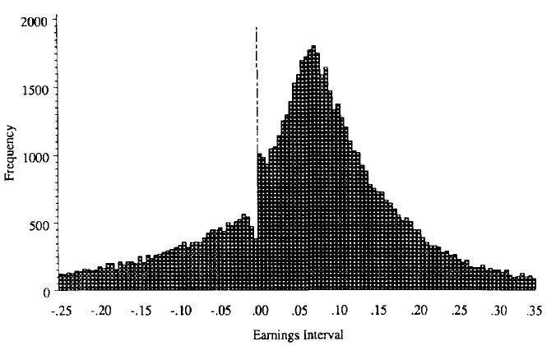
What is audit quality? (continued)
  3.1 Output-based audit quality measures (continued)
  financial reporting quality proxies – Jones (1991) model-estimated discretionary accruals (DAC), meet or beat earnings benchmarks, and Basu (1997) timely loss recognition (TLR). For example, Becker et al. (CAR 1998) show that (a) clients of non-Big N auditors are more likely to report income increasing and (b) the mean and median of absolute DAC of non-Big N auditors are larger. These findings are consistent with Big N auditors constraining clients’ earnings management to a greater extent than non-Big N auditors.
  Burgstahler and Dichev
  (JAE 1997) –
  Distribution of E/MVE
  Bin width = 0.005

Slide 8
What is audit quality? (continued)
  3.1 Output-based audit quality measures (continued)
  perception-based measures – earnings response coefficients (ERCs), stock market reaction to audit-related events, and the cost of capital. For example, it was debated that longer auditor tenure impairs auditor independence and audit quality. Ghosh and Moon (TAR 2005), however, show that ERCs increase with auditor tenure, i.e., the market perceives that auditors with longer tenure provide higher quality audits.

Slide 9
What is audit quality? (continued)
  3.2 Input-based audit quality measures
  auditor characteristics – auditor size or Big N membership and auditor industry specialization. Big N auditors are believed to provide higher quality audits because they have stronger incentives and greater competencies to provide high audit quality. Similarly, specialist auditors are believed to provide higher quality audits because they have greater competencies and also stronger incentives. For example, Reichelt and Wang (JAR 2010) measure specialist auditors at the national and city-office levels and they measure audit quality using (a) DAC, (b) beat and meet analyst forecasts by 1 cent, and (c) issuance of GC. They find that auditors who are a specialist at both national and city-level provide higher quality audits.
  auditor-client contracting features – audit fees and audit hours. Audit fees are used to proxy for audit quality because audit fees reflect auditor effort level, which relates to audit quality (but audit fees can also be related to audit risk, making audit fees an ambiguous proxy for audit quality). Audit hours reflect auditor effort and so can proxy for audit quality. For example, Caramanis and Lennox (JAE 2008) find that when audit hours are lower, (1) DACs are more often positive than negative, (2) positive DACs are larger, and (3) companies are more likely to meet or beat the zero earnings benchmark. That is, low audit hours are associated with low audit quality.

Slide 10
What is audit quality? (continued)
  3.2 Input-based audit quality measures (continued)
  financial reporting quality proxies – Jones (1991) model-estimated discretionary accruals (DAC), meet or beat earnings benchmarks, and Basu (1997) timely loss recognition (TLR). For example, Becker et al. (CAR 1998) show that (a) clients of non-Big N auditors are more likely to report income increasing and (b) the mean and median of absolute DAC of non-Big N auditors are larger. These findings are consistent with Big N auditors constraining clients’ earnings management to a greater extent than non-Big N auditors.
  perception-based measures – earnings response coefficients (ERCs), stock market reaction to audit-related events, and the cost of capital. For example, it was debated that longer auditor tenure impairs auditor independence and audit quality. Ghosh and Moon (TAR 2005), however, show that ERCs increase with auditor tenure, i.e., the market perceives that auditors with longer tenure provide higher quality audits.

Slide 11
The End
Thank You!

